Slide 1


NURS 420
Informatics
Unit IV
Nursing Informatics Practice Applications:
Care Delivery

Slide 2
Prayer for Today
"For we are his workmanship, created in Christ Jesus for good works, which God prepared beforehand, that we should walk in them.”
(Ephesians 2:10)

Slide 3
Informatics Timeline
Today Unit IV Chapters 17-22
For the Unit IV Class Participation Credit: This week post in the wikki your EBP article and paragraph. Due to post by 10/24/2012 noon.
End of PPT post your response to the chat question.
In your clinical group blackboard section: post the Unit IV Clinical Assignment for credit in the dropbox
NUR 320 eportfolio careplan in new NWC format; include spiritual care and reflection in comment box; and write a paragraph commenting on your professional student view on the new format. Due to post by 10/26/2012 noon.
Unit V Chapters 23-30 Face to Face in NAL 1:00-3:10 .

Slide 4
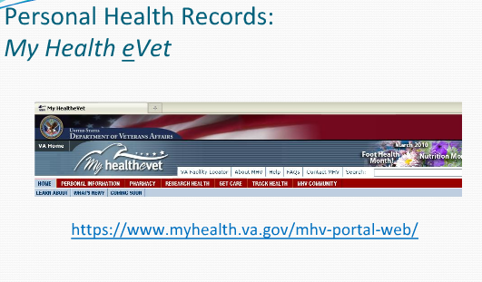

Slide 5

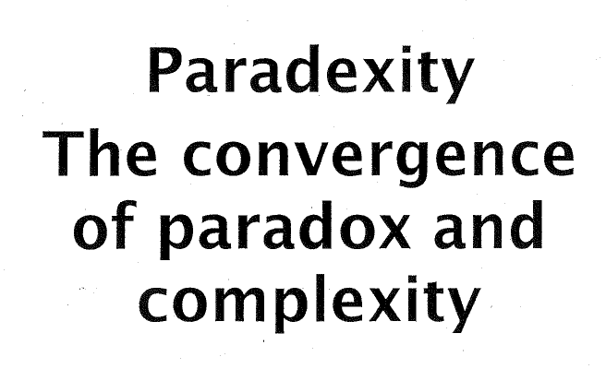

Slide 6
The Electronic Health Record and
Clinical Informatics

Slide 7
Objectives
Assess the benefits of implementing an electronic health record.
Evaluate the flexibility of the electronic health record in meeting the needs of clinicians and patients.

Slide 8
Definition of EHR
A data warehouse or repository of information regarding the health status of a client, replacing the former paper-based medical record;
It is the systematic documentation of a client’s health status and healthcare in a secured digital format, meaning that it can be processed, stored, transmitted and accessed by authorized interdisciplinary professionals for the purpose of supporting efficient, high quality healthcare across the client’s healthcare continuum

Slide 9
Push for Electronic Health Records
In January 2004, the President Bush raised the profile of electronic health records in his State of the Union address by outlining a plan to ensure that most Americans would have an electronic health record by 2014.
This goal was reaffirmed by President Obama.
American Recovery and Reinvestment Act of 2009 (ARRA), including the HITECH Act to specifically incentivize health organizations and providers to become “meaningful users” of EHRs.

Slide 10
Essential Components
Health information and data is the patient data required to make sound clinical decisions including demographics, medical and nursing diagnoses, medication lists, allergies and test results (IOM, 2003).
Results management is the ability to manage results of all types electronically including laboratory and radiology procedure reports, both current and historical (IOM, 2003).

Slide 11
Cont. Essential Components
Order entry management is the ability for a clinician to enter medication and other care orders directly into a computer including laboratory, microbiology, pathology, radiology, nursing, supply orders, ancillary services and consults (IOM, 2003).
Decision support is the computer reminders and alerts to improve the diagnosis and care of a patient.

Slide 12
Cont. Essential Components
Patient support is the patient education and self-monitoring tools including interactive computer based patient education, home telemonitoring and telehealth systems (IOM, 2003).
Administrative processes are the electronic scheduling, billing and claims management systems including electronic scheduling for inpatient and outpatient visits and procedures, electronic insurance eligibility validation, claim authorization and prior approval, identification of possible research study participants and drug recall support (IOM, 2003).

Slide 13
Cont. Essential Components
Electronic communication and connectivity is the online communication among healthcare team members, their care partners and patients including e-mail, web messaging, and an integrated health record within and across settings, institutions and telemedicine (IOM, 2003).

Slide 14
Cont. Essential Components
Reporting and population health management is the data collection tools to support public and private reporting requirements including data represented in a standardized terminology and machine-readable format (IOM, 2003).

Slide 15
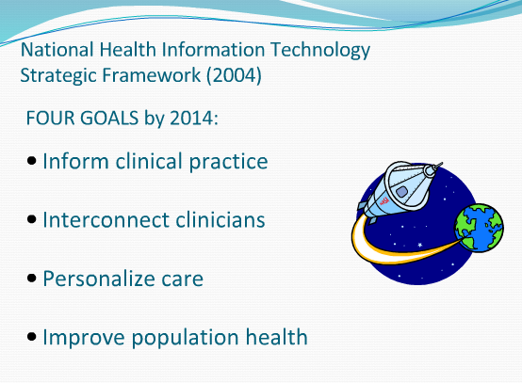

Slide 16
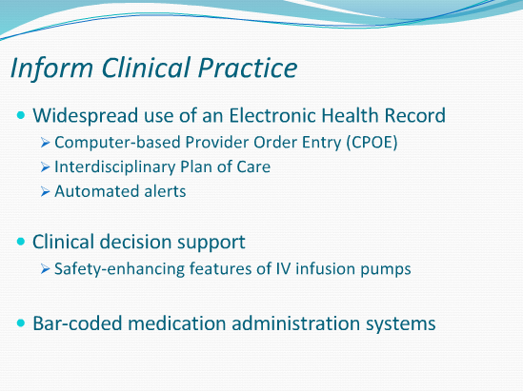

Slide 17
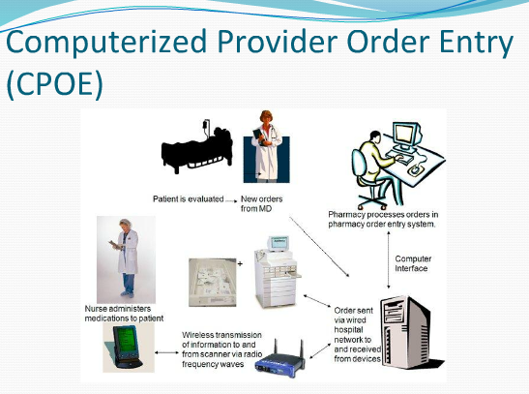

Slide 18
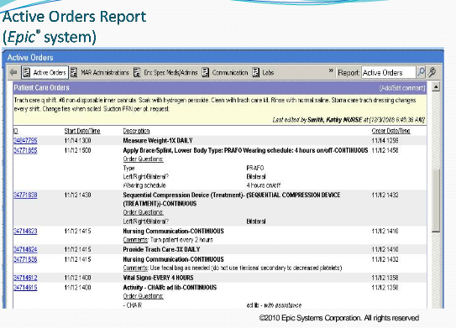

Slide 19
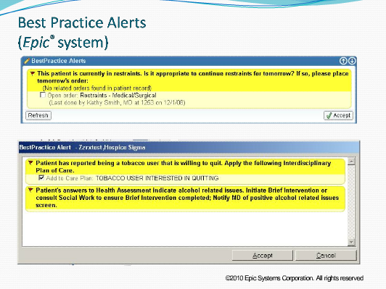

Slide 20
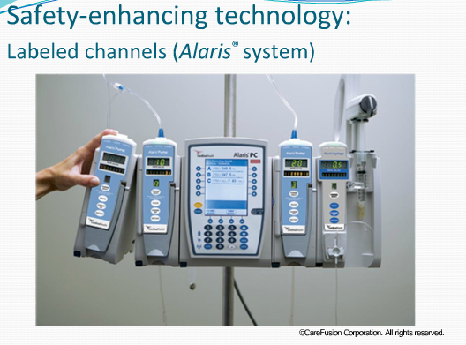

Slide 21
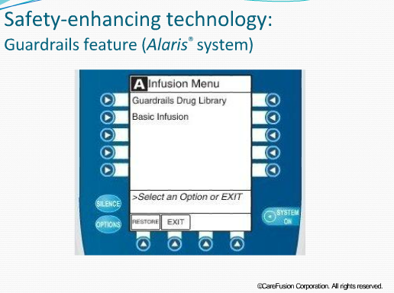

Slide 22
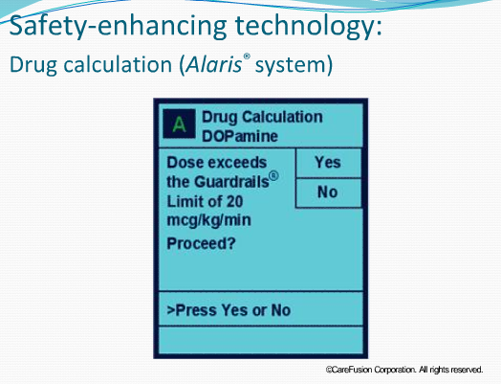

Slide 23
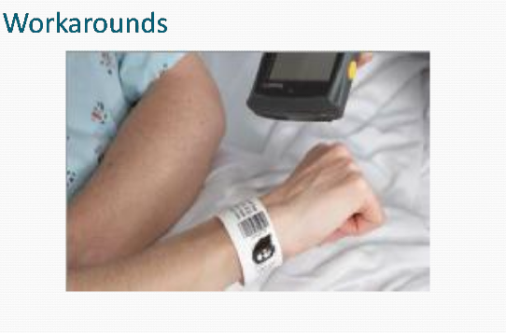

Slide 24
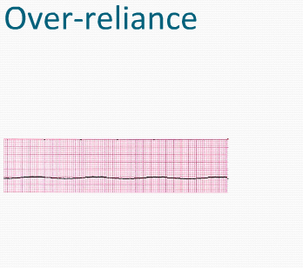
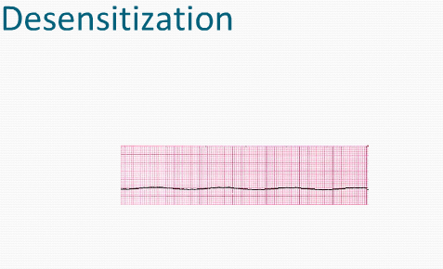
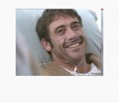
Caution

Slide 25
Davis Award recognizes successful EHR use
A recent winner demonstrated:
a significant avoidance of medication errors because of barcode scanning alerts,
a $3 million decrease in medical records expenses as a result of going paperless, and
a 5% reduction of duplicate laboratory orders by using computerized provider order entry alerting

Slide 26
Another Davis Award Winner
Noted a 13% decrease in adverse drug reactions through the use of computerized physician order entry, and
A decrease in methicillin-resistant Staphylococcus aureus nosocomial infections from 9.8 per 10,000 discharges to 6.4 per 10,000 discharges in less than a year using the EHR flagging function that made clinicians immediately aware that contact precautions were required on methicillin-resistant S. aureus–positive patients (HIMSS, 2009).

Slide 27
Future
Despite the challenges, the future of EHRs is an exciting one for patient and clinician alike.
Benefits may be realized by stand-alone EHRs as described here, but the most significant transformation will come as interoperability is realized between systems.

Slide 28
Future
There is a wealth of descriptive data available pointing to the benefits of an EHR.
Nursing must stay engaged in this evolution and help shape its direction, as it has already proven to have a significant impact on our practice and our patients.

Slide 29
Chat Post
What is your opinion in regards of the following statement: What are the implications of the following statement: Medical technology such as electronic health records (EHR) has become the standard for care moving nursing care away from caring in practice into an age where there is greater quality and safety and patients are more satisfied?

Slide 30
